Slide 1
PetCare App
Splash Screen
Get Started Screen
Main Activity
Pet Details

Slide 2
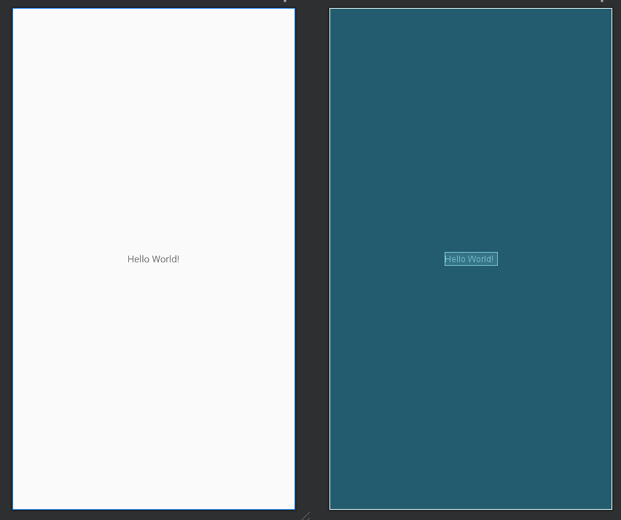
SPLASH SCREEN
https://gyazo.com/9168653624f052330b54a6c7bb146342
<?xml version="1.0" encoding="utf-8"?>
<android.support.constraint.ConstraintLayout xmlns:android="http://schemas.android.com/apk/res/android"
xmlns:app="http://schemas.android.com/apk/res-auto"
xmlns:tools="http://schemas.android.com/tools"
android:layout_width="match_parent"
android:layout_height="match_parent"
tools:context=".MainActivity">
<TextView
android:layout_width="wrap_content"
android:layout_height="wrap_content"
android:text="Hello World!"
app:layout_constraintBottom_toBottomOf="parent"
app:layout_constraintEnd_toEndOf="parent"
app:layout_constraintStart_toStartOf="parent"
app:layout_constraintTop_toTopOf="parent" />
</android.support.constraint.ConstraintLayout>

Slide 3
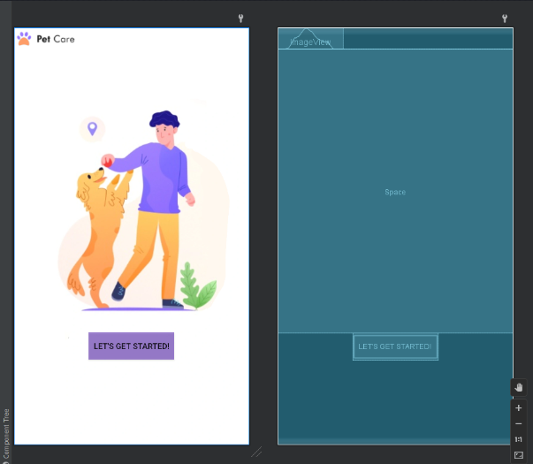
2. GET STARTED
<?xml version="1.0" encoding="utf-8"?>
<LinearLayout xmlns:android="http://schemas.android.com/apk/res/android"
xmlns:app="http://schemas.android.com/apk/res-auto"
xmlns:tools="http://schemas.android.com/tools"
android:orientation="vertical"
android:layout_width="fill_parent"
android:layout_height="fill_parent"
android:background="@drawable/foto2">
<TextView
android:id="@+id/textView2"
android:layout_width="match_parent"
android:layout_height="wrap_content"
android:gravity="center_horizontal"
android:text="SUPER TEXT 2"
android:textDirection="firstStrongRtl"
android:textIsSelectable="true"
android:textSize="48sp" />
<EditText
android:id="@+id/editTextTextMultiLine"
android:layout_width="match_parent"
android:layout_height="wrap_content"
android:ems="10"
android:gravity="center_horizontal|center_vertical"
android:inputType="textMultiLine"
android:padding="10px"
/>

Slide 4
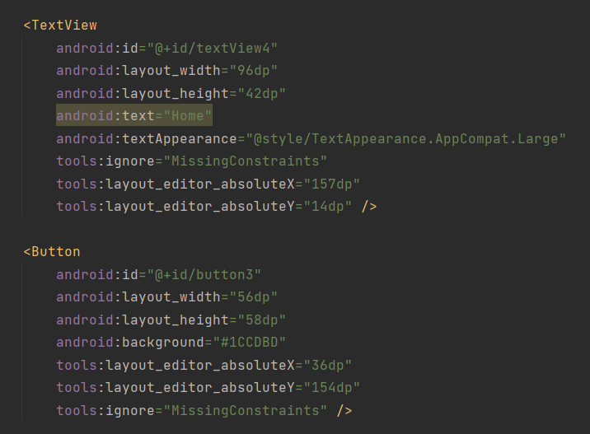
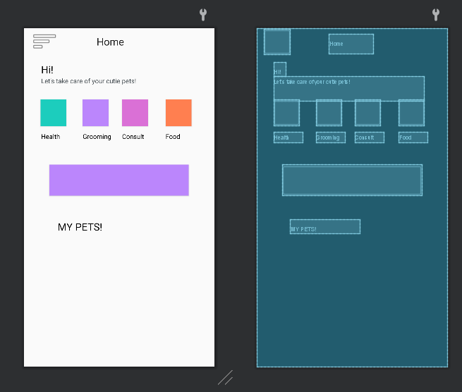
3. MAIN ACTIVITY

Slide 5
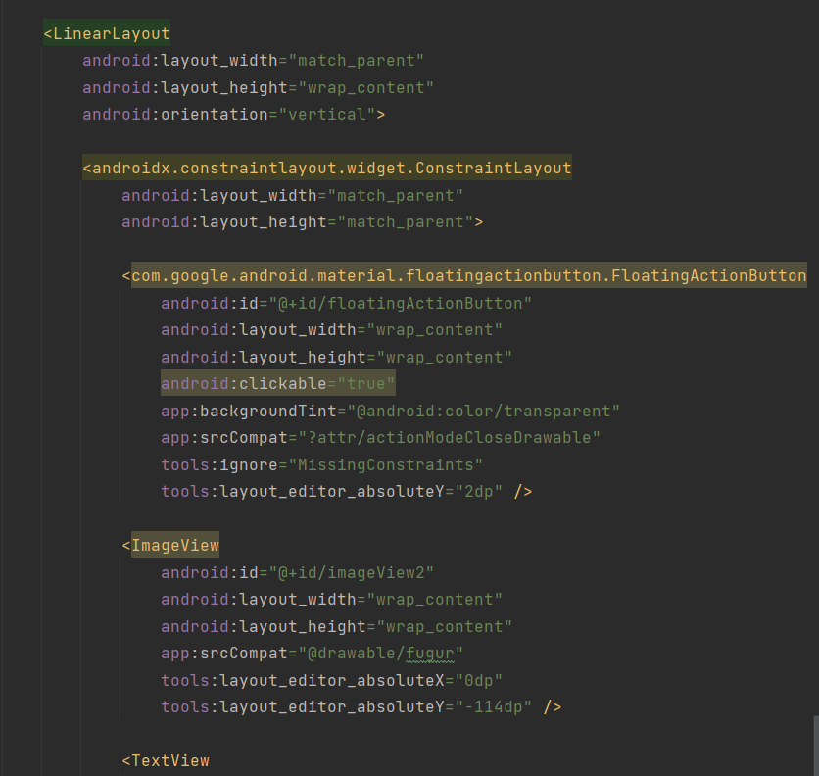
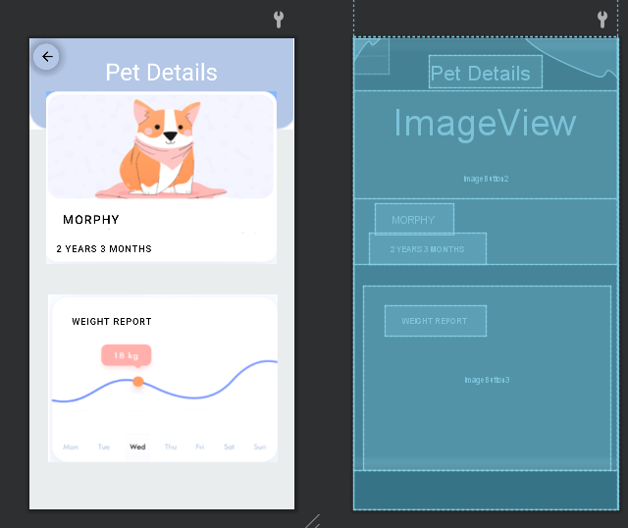
4. PET DETAILS

